Slide 1
Design Patterns – Mobile Apps
Swapnil parashar

Slide 2
Design Patterns – Mobile Apps
Mobile App Development – Key attributes to keep in mind
Evolution of New Patterns and Practices for Mobile App Development
Mobile App Patterns for Interaction
Mobile App Patterns for Presentation
Mobile App Patterns for Behaviour
Summary

Slide 3
Mobile App Dev – Key Attributes
Mobile Apps is different to Web / PC solutions
Different devices – H/W
Different OS versions
Different screen sizes
Different screen resolution
Touch screen
Storage
Connectivity
RAM / Memory
Screen orientation

Slide 4
Mobile App Dev – Key Attributes
The Interaction Model
Key difference in interaction in mobile apps is the use of touch screen compared to use of keyboards and mouse in desktop applications
Using touch screen with a finger is quite a natural and pleasant experience for the user but not if the clickable item is too small
Also a touch screen finger can never be as precise as a mouse pointer
This is addressed at design level of mobile apps by keeping usability practices in mind

Slide 5
Mobile App Dev – Key Attributes
The Presentation Model
Challenges:
Larger buttons and links sizes for touch sensitive screens
Small mobile screens so UI elements sizes need to be limited
New rules for presentation
Scrolling is encouraged mostly vertically
Horizontal scrolling is usually replaced with Swipes or Flips

Slide 6
Mobile App Dev – Key Attributes
The Behaviour Model
Limited resources – CPU, GPU, Memory, Storage etc.
Memory consumption must be strictly controlled and optimizing algorithms must be used
Strong multi-tasking logic required
Switching between apps must be made easy and error free
Variety of issues faced by developers are new and challenging

Slide 7
New Patterns & Practices - Mobile
Mobile Design Patterns apply to all OS and development platform
Mobiles Design Patters are necessary to keep mobile apps effective and aligned with the needs and expectations of users
Patterns affect 3 main programming areas:
Application Life Cycle
Storage
Connectivity

Slide 8
New Patterns & Practices – App Life Cycle
Background Apps – these vary across different mobile OS / platforms like Android, IOS, Windows etc.
Fully unlimited multi-tasking cannot be attained
Apps states varying mostly among the following states:
Actively running
Paused with pending work / waiting to be resumed
Unloaded
Actual implementation varies and differs among various mobile OS / platforms

Slide 9
New Patterns & Practices – Storage
Mobile apps are fundamentally conceived to be stand-alone apps
Sharing data in mobile apps is tricky and requires use of API’s and advanced programming
Various Mobile OS / platforms provide various mechanisms to persist data locally on the device:
Custom files
Local database
System-managed data repositories

Slide 10
New Patterns & Practices – Storage
Custom Files
Stream-based programming interface
Specific section of file system and persistent data for the app is isolated
In Android, access to SD cards and control over visibility of the files
In iOS and Windows, tricks like iCloud and SkyDrive res.
Local Databases
SQLite – very popular in Android (Java) and iOS (C)
MS SQL Compact Edition and Sync Framework for Windows
System-managed repositories
SharedPreferences in Android
Settings bundle facility in iOS

Slide 11
New Patterns & Practices – Connectivity
Most apps require connectivity but not always
Mobile connectivity not reliable
UI and network-dependent operations need to be designed in a way that provides good user experience and also have the feature / functionality implemented – Balance between number of retries and giving up in attaining network connection
UI elements need to be enabled / disabled based on network connectivity or even when detecting change in network
Network changes:
Mobile data vs Wi-Fi
Private vs Public Wi-Fi
Good vs bad connectivity / GPS

Slide 12
Mobile App Patterns for Interaction
The Back-and-Save Pattern
Core idea is to minimise the typing effort (re-type)
Save the content when the user leaves the screen
No explicit action or save button required
Implementation
Timer to save at intervals
Auto-save when screen is unloaded
Save as you go

Slide 13
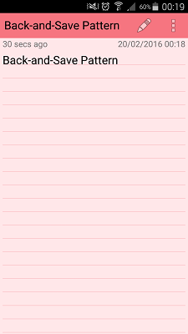
Mobile App Patterns for Interaction
The Back-and-Save Pattern
Color Note App –Both back and home button saves text automatically

Slide 14
Mobile App Patterns for Interaction
The Guess-Don’t-Ask Pattern
Core idea is to limit data entry by the user
Minimize user clicks, typing and interaction by use of any available resources to make intelligent guesses
Offer suggestions to users and guess what they would most likely do
Implementation
Prefill fields with geo-information
Auto word completion / suggestions
Voice based inputs

Slide 15
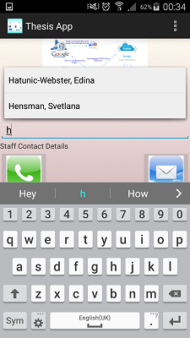
Mobile App Patterns for Interaction
The Guess-Don’t-Ask Pattern
Thesis App does auto-complete options for Contact List

Slide 16
Mobile App Patterns for Interaction
The A-la-Carte-Menu Pattern
Core idea is to make user aware of all available options from the beginning
At any time, it should be clear to the user which action to take
At any time, it should be clear to the user of the number of options available
Any functionality should be no more than 2 or 3 clicks away
Implementation
Selection of use-cases for a particular user and app
Options menu easy to access, read and interpret
Supporting hiding over disabling controls based on user’s context

Slide 17
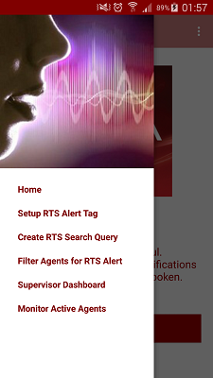
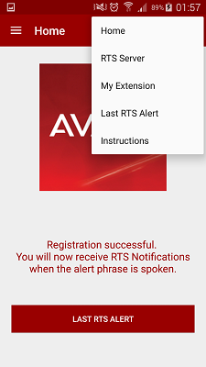
Mobile App Patterns for Interaction
The A-la-Carte-Menu Pattern
Avaya’s Real Time Speech Alert App – always 2 clicks for all options and only 2 clicks away from any feature / functionality

Slide 18
Mobile App Patterns for Interaction
The Sink-Or-Async Pattern
Asynchronous implementations for potentially longer operations
Implementation
Using worker thread to make synchronous request
Asynchronous API’s available by the native SDK’s
Chaining Async Network Operations
If only Async API is available then design the code to maintain a high level of readability with 2 or even 3 sequential calls
More the number of sequential calls, the messier the solution becomes

Slide 19
Mobile App Patterns for Interaction
Use of Coroutines provides the solution
while (!Task1_isComplete || !Task2_isComplete || !Task3_isComplete) {
if(!Task1_isPending && !Task1_isComplete)
ExcecuteTask1(…)
if(!Task2_isPending && !Task2_isComplete)
ExcecuteTask2(…)
if(!Task3_isPending && !Task3_isComplete)
ExcecuteTask3(…)
}
Various properties used for controlling the loop are wrapped as members of a class and set by ExecuteTaskN procedures as appropriate
Operations written as distinct Async tasks and surrounding routine ensures overall workflow runs steps in right sequence

Slide 20
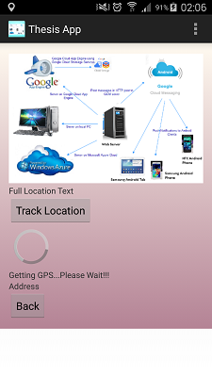
Mobile App Patterns for Interaction
The Sink-Or-Async Pattern
Thesis App waits for GPS location to load in Async task

Slide 21
Mobile App Patterns for Interaction
The Logon-And-Forget Pattern
Credentials to be entered once, stored safely and transparently used to authenticate the user in every session (just like most websites)
Implementation
First time login screen with username and password, no remember me.
Store credentials or user token
Keep credentials stored until user explicitly logs out
Security aspect
Make it optional or avoid using this pattern
Always use encryption

Slide 22
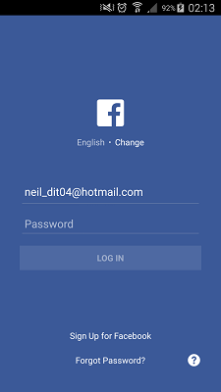
Mobile App Patterns for Interaction
The Logon-And-Forget Pattern
Facebook login remembers your successful login until logout done explicitly

Slide 23
Mobile App Patterns for Presentation
The Babel-Tower Pattern
Avoid hard-coded and fixed layout txt.
Support dynamic injection of properly translated text
Internationalization (I18n) vs. Localization (L10n)
I18n = internal architecture to support multiple languages & regional settings.
L10n is the specific action to support a specific language
Implementation
Replacing text over all screens
Replacing graphics
Replacing screen layouts
Replacing specific portions of app logic

Slide 24
Mobile App Patterns for Presentation
The Do-As-Romans-Do Pattern
It is more of a guiding principle rather than a concrete detailed strategy to solve a common problem.
Abide by the look and feel of the host operating system in your app design and implementation
Implementation
Keep overall user interface as close as possible to the standards of the platform
Refer to design guidelines of the platform being targeted

Slide 25
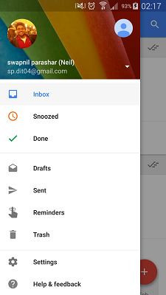
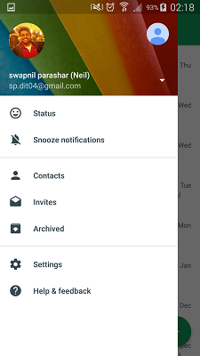
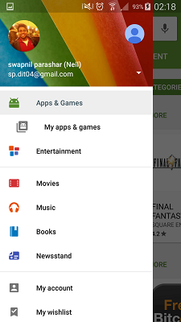
Mobile App Patterns for Presentation
The Do-As-Romans-Do Pattern
Google Apps

Slide 26
Mobile App Patterns for Presentation
The List-And-Scroll Pattern
Vertical scrolling for list items (even 100 items).
Using Swipe rather than Horizontal scrolling
Implementation
Using lists is very common though implementation differs for different mobile platforms
Pagination to be used for 100 plus items to keep memory in check
Applied to App’s UI as well as toolbars

Slide 27
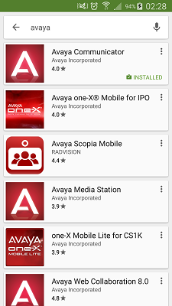
Mobile App Patterns for Presentation
The List-And-Scroll Pattern
Google Play Store: all apps in a list and option to scroll: search for Avaya

Slide 28
Mobile App Patterns for Behaviour
The Predictive Fetch Pattern
Historically bound to AJAX – ability to place out-of-bound calls to web server and getting raw data instead of full-blown HTML pages
Core idea is to try and fetch ahead
If dependency on connectivity then data downloaded that is likely to be used later and having enough data at any time to survive lack of connectivity
Implementation
Analytics usage to predict what is being used at what time
Design code to get a hold of data you may need next using this predictive analysis

Slide 29

Mobile App Patterns for Behaviour
The Predictive Fetch Pattern
Facebook loads more items than shown on screen, only scrolling to bottom it then starts loading even more

Slide 30
Mobile App Patterns for Behaviour
The Memento-Mori (Remember you will die) Pattern
Latin phrase and is reminder of the mortal condition of the app
Always save relevant state when forced into the background by the OS
Every App is responsible for determining what data to save and how
Implementation
Object’s ability to save its public state to a stream so that brand new instance with the same state can be created later. Also termed as Object Serialization (Java concept)
In Java, two things are necessary for class to be serialized successfully
Class must implement java.io.Serializable interface
All fields in class must be serializable. If a field is not serializable, then it must be marked transient.
All programming frameworks provide good native support for object serialization

Slide 31
Mobile App Patterns for Behaviour
The As-Soon-As-Possible Pattern
App’s critical remote operations (to work with and without network) must be implemented in a protected manner and reiterated a few times before failing. These operations should be recorded and played back as connectivity returns
“Perform this task as soon as possible and any way you can, at your earliest convenience”
Strictly related to network operations such as POST of data to a remote server
Implementation
Black-or-White algorithm:
Attempt to perform the operation. If it fails, notify the user and add the operation to an internal queue
Grayscale algorithm:
Break down the data to post in small pieces (few kb) and attempt to send them separately

Slide 32
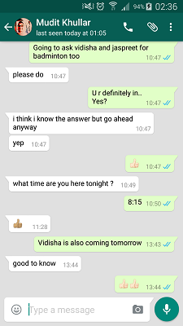
Mobile App Patterns for Behaviour
The As-Soon-As-Possible Pattern
WhatsApp – sending messages queued and sent whenever network is back

Slide 33
Summary
Mobile apps development very different to desktop or web applications regardless of the target platform and the details of the SDK being used
Overall an easier task as far lower number of use-cases to plan compared to web or desktop applications
However there are still a number of challenges involved in mobile apps development
Discussed various design patterns in detail under following categories:
Interaction
Presentation
Behaviour

